Slide 1

Case Law Update
Emily Fildes
Barrister at Cobden House Chambers
Manchester
Cumbria Family Justice Conference 2025

Slide 2
PUBLIC LAW - CASE LAW UPDATES

Slide 3
Re A & Ors (Care Orders at Home) [2025] EWCA Civ 901
FACTS
Five subject children: four girls - A, aged 13, B, aged 12, C, aged 10, D, aged 9 - and a boy, E, aged 8.
Timeline of proceedings:
The family had long-term involvement with the local authority, including previous care proceedings in 2019 concerning all eight children (3 additional subject children). Findings were made against the father for physical abuse and the mother for failing to protect. Despite the Children’s Guardian recommending care orders, the court made no orders, urging the parents to attend parenting courses.
In February 2024, concerns resurfaced when A (aged 11) repeatedly went missing and reported physical abuse and threats from her father. The parents refused to engage with social services and missed a child protection conference in May 2024. Police investigated but took no action.
On 24 May 2024, A was involved in a violent altercation with another girl, allegedly encouraged by her parents, who failed to intervene. The father was heard on video preventing others from stopping the fight.
On 29 May 2024, the local authority initiated care proceedings and sought interim care orders. An agreement was made for the children to stay home under a safety plan, excluding the father from the home and requiring supervised contact. The parents never signed the plan and allegedly breached its terms.
The father stopped attending contact visits in late September 2024, and concerns arose that he was secretly visiting the home.
In June 2024, A was expelled from school.
In October 2024, A attempted suicide by overdose, citing guilt over her father's absence in the family home and bullying. Video evidence confirmed she had been bullied by peers.

Slide 4
Re A & Ors (Care Orders at Home) [2025] EWCA Civ 901 – continued
FACTS CONTINUED
The parents failed to cooperate with the local authority’s attempts to arrange an independent assessment. Despite concerns, the local authority initially proposed that the children remain at home under care orders, acknowledging positive aspects of parenting and the children's strong attachment to their mother.
The final hearing was listed before HHJ Tyler over five days starting on 3 March 2025.
At the final hearing in March 2025, after the mother stated she would not work with the local authority or allow social workers into the home, the local authority changed its care plans to seek the removal of all five children.
An interim removal application was refused in favour of a working agreement, but the parents refused to sign or follow it. During the adjournment, they took the children to Blackpool, breaching the father’s contact restrictions.
When the hearing resumed in April 2025, the local authority sought care orders with plans to remove all five children:
A to a therapeutic residential placement
B and C to one foster placement
D and E to another foster placement
The parents opposed all care plans, denied the threshold criteria were met, and argued that all children should stay at home with no orders or further local authority involvement.
The only local authority final care plan available to the court was one of removal.

Slide 5
Re A & Ors (Care Orders at Home) [2025] EWCA Civ 901 – continued
JUDGMENT
Judgment was delivered on 2 May 2025.
HHJ Tyler made findings including reference to the earlier proceedings, the incident involving A on 24 May 2024, the fact that A had gone missing on a number of occasions, that the father had had contact with the children in breach of the contract of expectations, and a finding that the parents were "unwilling to meaningfully engage with the local authority and have frustrated efforts of reducing and monitoring the risks to the children, resulting in the children being at risk of physical and emotional harm”.
HHJ Tyler concluded that ‘"It is not therefore the case that [the mother] cannot and will not work with professionals, but as a couple [they] have taken what I can only describe as an intransigent position, an immovable position in that regard latterly. I think [the father] has been fairly resolute from the start that he is not going to cooperate with the Local Authority because he did not see a reason to, but [the mother] has been more flexible at times. By the conclusion of the evidence, it was clear that [she] had adopted the same position, in general terms, as [the father].”
Outcome
After providing her welfare decision, the court made final care orders in respect of each child, with each child remaining at home with the mother.
No workable or final care plan to align with the court’s welfare decision.

Slide 6
Appeal Grounds
The Local Authority and the Father sought permission to appeal the care orders:
The Father | The Local Authority
1. The Judge failed to undertake a sufficient analysis of the necessity and proportionality of the making of care orders in the context of the risks arising from the threshold findings made. | 1. The Judge failed to properly evaluate the risk to the children if they remained in their mother's care and was wrong to make final care orders on the basis that they remain with the mother while the father has family time supervised by the local authority.
2. She failed to analyse sufficiently why the case was one of the exceptional nature necessary to justify the making of care orders with placement of the children at home. | 2. She failed to weigh and balance the totality of the evidence available to her and so the factual findings, by not finding that the father had caused physical harm to the children, were flawed.
3. She failed to provide an adequate analysis as to why an injunctive order excluding the father from the family home was necessary and proportionate in the context of the risks arising from the threshold findings made.

Slide 7
Appeal Allowed
The Court of Appeal found it was unlawful for HHJ Tyler to make final Care Orders in the absence of valid care plans.
There should have been an adjournment to allow the Local Authority an opportunity to re-consider its’ position in light of the judge’s welfare decision.
It was unnecessary for the Court to determine the individual grounds of appeal raised by the Local Authority and the father.
Final care orders set aside and interim care orders reinstated.
Matter remitted for a full re-hearing before an alternative Judge, to be identified by the Designated Family Judge for Greater Manchester

Slide 8
Re A & Ors (Care Orders at Home) [2025] EWCA Civ 901 – Analysis
At paragraph 25 of the judgment, Lord Justice Baker held that:
’25. The fundamental problem is this. Under s.31(3A) of the 1989 Act, "no care order may be made with respect to a child until the court has considered a section 31A plan." When the judge made final care orders in respect of all five children, she did not have before her a plan which made provision for the children to live at home. The plans filed at the start of the final hearing had been withdrawn. The local authority was now proposing the removal of the children, and therefore no plans to that effect had been formulated. Accordingly, it was not lawful for the judge to make a final care order at that stage. Given her conclusion that the children should remain at home with the mother, the right course would have been to adjourn the hearing and invite the local authority to reconsider its plans for the children in the light of her judgment. Such a course was particularly important given the sharp divergence between her conclusions and the local authority's position.’

Slide 9
Re A & Ors (Care Orders at Home) [2025] EWCA Civ 901 – Analysis
At paragraph 26 of the judgment, Lord Justice Baker stressed that:
‘26. It was even more important, given her proposal that the children should remain at home under care orders. In Re JW (Child at home under care order) [2023] EWCA Civ 944, at paragraph 66, Sir Andrew McFarlane P, in a judgment with which the rest of the court agreed, endorsed the conclusion of the President's Public Law Working Group that:
"a care order on the basis that the child will be living at home should only be made when there are exceptional reasons for doing so. It should be rare in the extreme that the risks of significant harm to a child are judged to be sufficient to merit the making of a care order but, nevertheless, as risks that can be managed with the child remaining in the care of parents.”

Slide 10
Re A & Ors (Care Orders at Home) [2025] EWCA Civ 901 – Analysis
Lord Justice Baker went on to state:
‘26. For that reason, any proposal that a child remain at home under a final care order requires particularly careful analysis. In the present case, the court was concerned with five children with different needs and vulnerabilities. It was also concerned with two parents who had resolutely refused to co-operate with the local authority. In those circumstances, it was plainly wrong for a final care order to be made, vesting the local authority with the overriding parental responsibility that comes with such orders under s.33(3) of the Act, without allowing the local authority the opportunity to give careful consideration to the judge's evaluation of the children's welfare and, if it considered it possible, to devise plans that enabled her conclusion to be put into effect. It was also essential for the children's guardian to have the opportunity to respond to the local authority's plans.’

Slide 11
Re A – Take Home Points
No care order may be made with respect to a child until the court has considered a section 31A plan (s.31(3A) of the 1989 Act)
A care order on the basis that a child will be living at home should only be made when there are exceptional reasons for doing so (Re JW (Child at home under care order) [2023] EWCA Civ 944)
The final care plan for a child to remain under a care order at home requires particularly careful analysis, plan and consideration.

Slide 12
Re M (A Child: Intermediaries) [2025] EWCA Civ 440
FACTS
An appeal which arose from the refusal of HHJ Thomas to grant the mother’s application for intermediary assistance in care proceedings. The mother had been assisted by an intermediary at three previous case management hearings.
In January 2024, the mother’s baby suffered a skull fracture at the age of ten months. He had been living in a household with both parents, his maternal grandmother and a teenage maternal uncle. On discharge from hospital, he was placed with other family members and, as the injury was unexplained, care proceedings were started.
At the time of the decision under appeal, an eight-day fact-finding hearing to determine how the child came by his injury was due to begin on 17 February 2025. The hearing was adjourned to September 2025.
The appeal was supported by the respondent parties.

Slide 13
Re M (A Child: Intermediaries) [2025] EWCA Civ 440
What is an intermediary?
Intermediaries are communication specialists that work on behalf of HMCTS to support vulnerable people to communicate more effectively in court proceedings
Communicourt, The Intermediary Cooperative or Triangle.

Slide 14
Appeal Allowed
Appeal allowed
The Court of Appeal determined that HHJ Thomas paid ‘insufficient attention to the mother’s difficulties’ (paragraph 73-74) and instead relied on previous case law which stated appointing an intermediary would be a ‘rarity.’
Intermediary appointed for the mother to assist in further case management hearings, the fact-finding hearing and the legal conferences at court on the above occasions, the cost to be met by HMCTs.

Slide 15
Re M (A Child: Intermediaries) [2025] EWCA Civ 440 - Analysis
APPLICABLE PRINCIPLES
Jackson LJ summarised the applicable principles to be considered when making an application for an intermediary, which are as follows:
‘7 In deciding whether and, if so, for what purpose to approve the appointment of an intermediary:
The court will exercise its judgement within the framework of Part 3A of the Family Procedure Rules 2010 (‘the FPR’) and Practice Direction 3AA. These provisions are not complex, and they require very little elaboration. Their relevant parts appear in the Annex below. By following them, the court will steer a path between the evils of procedural unfairness to a vulnerable person on the one hand, and waste of public resources on the other.
The test for the appointment of an intermediary for any aspect of proceedings is that it is necessary to achieve a fair hearing. Decisions are person-specific and task-specific, and the introduction of other tests upsets the balance struck by the FPR and may draw attention away from the circumstances of the individual case.
Efficient case management will assist sound decision-making in this area. There must be early identification of vulnerability where it exists. Intermediaries are not experts, but applications for intermediary support should be approached with similar procedural discipline. Different considerations may apply to different elements of the proceedings, and the court should normally require an application notice and/or a draft order that specifies the exact extent of the requested assistance.
Correctly understood, the court’s powers are wide enough to permit it to authorise intermediary assistance for legal meetings outside the court building. However, support that is necessary in the courtroom may be unnecessary in a less pressured setting. Accordingly, the court should give separate consideration to any application of that kind.

Slide 16
Re M (A Child: Intermediaries) [2025] EWCA Civ 440
APPLICABLE PRINCIPLES - CONTINUED
‘7
(5) The Family Court is accustomed to using checklists when making procedural and substantive decisions. The mandatory checklist in FPR rule 3A.7 is an essential reference point to ensure that the factors relevant both to the individual and to the proceedings are taken into account. The weight to be given to them is a matter for the court, making a broad and practical assessment.
(6) An application for an intermediary must have an evidential basis. This will commonly take the form of a cognitive report and, if authorised, an intermediary assessment. Other evidence may come from the social worker or the Children’s Guardian. The court can also take account of submissions on behalf of the vulnerable person, and from the other parties, as they may have their own perspectives on the overall fairness of the proceedings. This reflects the collaborative nature of the task of identifying and making adjustments for vulnerability. Whatever the evidence and submissions, it is for the court, and not others, to decide what is necessary to achieve a fair hearing in the individual case.
(7) When considering whether an intermediary is necessary, the court will consider other available participation directions. In some cases they will be effective to secure fairness, so that an intermediary is unnecessary, or only necessary for a particular occasion, while in other cases they will not. The court is entitled to expect specialist family lawyers to have a good level of understanding of the needs of vulnerable individuals in proceedings and an ability to adapt their communication style. It will consider what can reasonably be expected of the advocates, and in particular of the vulnerable party’s advocate in the individual case, bearing in mind that professional continuity may not be guaranteed. Intermediaries should clearly not be appointed on a ‘just in case’ basis, or because it might make life easier for the court, but equally advocates should not be required to stray beyond their reasonable professional competence to make up for the absence of an intermediary where one is necessary.
(8) The rules provide that the reasons for a decision to approve or refuse participation directions for a vulnerable person must be recorded in the order. That can be done very briefly, and it is a further useful discipline.
(9) The approach described should ensure that intermediaries are reliably appointed whenever they are necessary, but not otherwise.

Slide 17
Re M – Take Home Points
The test for the appointment of an intermediary is that it is necessary to achieve a fair hearing.
An application for an intermediary should properly be made early on in proceedings.
An application for an intermediary must include supporting evidence, such as a cognitive assessment, intermediary assessment or supporting evidence from the social worker or the Children’s Guardian.
When considering an application for an intermediary assessment, the court must apply the framework provided for by Part 3A and Practice Direction 3AA.
Advocates are expected to have a good level of understanding of the needs of vulnerable individuals in proceedings and adapt their communication style, but should not be required to stray beyond their reasonable professional competence to make up for the absence of an intermediary where one is necessary.
The reasons for a decision to approve or refuse participation directions for a vulnerable person must be recorded in the order.

Slide 18
PRIVATE LAW - CASE LAW UPDATES

Slide 19
ER v NT [2025] EWHC 2146 (Fam)
FACTS
The parties commenced their relationship in 2002 and cohabited from 2005.
Their daughter, CT, was born on 22 March 2023.
In 2023, the parties separated.
The Father sought a section 8 child arrangements order for contact with CT.
Mother made extensive allegations against the Father spanning the entirety of their relationship from 2005 to 2023.

Slide 20
ER v NT [2025] EWHC 2146 (Fam)
FACTS - CONTINUED
Mother’s allegations against the Father encompassed a pattern of alleged domestic abuse and coercive control, including:
Multiple episodes of the Father’s drug-induced psychosis and sectioning under the Mental Health Act 1983;
The Father’s Habitual cocaine use from 2007 onwards;
Physical violence against the Mother, including allegations of being held at knifepoint, threatened with a hammer, and having breathing obstructed;
Coercive and controlling behaviour at the hands of the Father, including monitoring telephone calls, accusations of infidelity, and isolation from social contacts
Emotional and verbal abuse perpetrated by the Father throughout the relationship and following CT’s birth; and
Undermining behaviour regarding the Mother’s parenting capacity.
The Father’s Admissions, recorded in an order of 15 August 2024, were significantly more limited.
The Father denied or claimed inability to recall the majority of allegations involving physical violence, threats to kill, and systematic coercive control.

Slide 21
ER v NT [2025] EWHC 2146 (Fam)
Mother pursued an application for a finding of fact hearing.
First Decision
HHJ Godwin dismissed the mother’s application for a fact-finding hearing, concluding that sufficient information existed to assess risk without such a hearing. The Judge made his decision on the basis of four principal factors:
The father’s admissions established the mother as “a vulnerable person in relation to F” and provided adequate foundation for risk assessment under paragraph 37 of Practice Direction 12J.
Significant weight was placed upon the Judge’s finding that “none of the serious allegations post-date birth of CT on 22/03/23”, noting a three-month period of post-separation contact without reported difficulties.
Considerable reliance was placed upon the father’s completion of a three-day anger management course with ‘Anger Planet’, with the judge noting Mr Woolfson’s assessment that the father had “taken a very adult attitude towards his past behaviour”.
A fact-finding hearing would require listing 9-12 months hence, with subsequent Cafcass reporting adding further delay, totalling approximately 18 months.

Slide 22
Appeal Grounds
Mother sought permission to appeal the decision of HHJ Godwin, on five grounds:
The Judge failed to give adequate reasons for dismissing the mother's application for a finding of fact hearing.
The Judge was wrong in failing to specifically address PD12J in light of the disputed allegations of domestic abuse.
The Judge failed to conduct an analysis of the evidence and/or gave undue weight to some of the evidence.
The Judge was wrong to place reliance on the course completed by the father with 'Anger Planet'.
The Judge failed to consider PD12J before making an order for indirect contact.

Slide 23
Appeal Allowed
High Court Decision
Mr Justice MacDonald, sitting in the High Court, allowed the appeal on Grounds 1, 3, and 4, dismissed Grounds 2 and 5.
The Judge failed to give adequate reasons for dismissing the mother's application for a finding of fact hearing – allowed.
The Judge was wrong in failing to specifically address PD12J in light of the disputed allegations of domestic abuse - dismissed.
The Judge failed to conduct an analysis of the evidence and/or gave undue weight to some of the evidence - allowed.
The Judge was wrong to place reliance on the course completed by the father with 'Anger Planet’ – allowed.
The Judge failed to consider PD12J before making an order for indirect contact - dismissed.
Consequential Directions on Appeal
The matter was remitted for a fact-finding hearing before a different Circuit Judge.

Slide 24
ER v NT [2025] EWHC 2146 (Fam) - Analysis
Mr Justice MacDonald identified the following critical failures in the lower court’s approach:
Failure to identify and analyse specific welfare issues arising from admitted domestic abuse: [§ 66, 68]
Failure to recognise allegations as constituting a pattern of coercive and controlling behaviour spanning decades [§ 69-70].
Erroneously concluding that limited admissions provided “sufficient information” rather than “sufficient factual basis to proceed” [§71], see also §54].
Failing to recognise the “stark disparity” between father’s limited admissions and mother’s extensive allegations [§71-72].
Inappropriate weight placed upon three-day course contrary to Cafcass guidance that anger management is unsuitable for domestic abuse cases [§73]
Contradictions in simultaneously concluding fact-finding was unnecessary whilst directing Cafcass to assess risk based on disputed allegations [§76-77].

Slide 25
Appeal Allowed
What questions must the court address?
At paragraph 65 of the judgment, Mr Justice MacDonald sets out the questions that must be actively engaged with by the court where a fact-finding hearing is being considered:
‘65 In the foregoing context, in order for the parties to understand why they have won or lost on the case management issue in dispute in this case, and to provide sufficient detail and analysis to enable an appellate court to decide whether or not the judgment is sustainable ,it should be apparent from the judgment that the judge has addressed, in short but sufficient detail, three questions:
What are the identified welfare issues?
What is the nature of the disputed allegations?
Are the matters alleged relevant to the welfare issues such that it is necessary and proportionate, having regard to the purpose of a fact finding hearing as the basis of assessment of risk and the impact of the alleged abuse on the child, the impact of delay and whether there is other evidence providing a sufficient factual foundation, for the allegations to be determined?’

Slide 26
ER v NT – Take Home Points
A decision as to whether to hold a finding of fact hearing must properly:
Identify welfare issues;
Consider the nature of the disputed allegations;
Determine whether the allegations are relevant to the welfare issues such that a fact-finding hearing is necessary; and
Properly analyse the principles in PD12J.
The court’s decision must be based on a sufficient factual foundation and must include proper reasoning, particularly in cases involving allegations of coercive and controlling behaviour.
Analysis must be given to the extent of courses undertaken by parents, and if necessary, consultation be had with Cafcass (Cafcass Domestic Abuse Practice Guidance).

Slide 27
V v V & Anor [2025] EWHC 945 (Fam)
FACTS
In May 2021, during Family Law Act (FLA 1996) proceedings, Recorder Sharp KC made findings against the father for sexually assaulting the mother, coercive and controlling behaviour, physical harm to the child, and exposing the child to parental conflict.
Some limited contact followed.
In April 2023, F applied for increased contact.
On 5 September 2024, a final child arrangements order (largely by consent) was made, providing that the child would live with M and have regular contact with F, including overnight stays.
Although M raised further allegations during those proceedings, the court did not hold a fact-finding hearing due to the existing FLA findings and mutual agreement. M later claimed she was coerced into agreeing to the order, but there was no evidence of this and she did not appeal.
On 12 December 2024, M applied to suspend contact, citing new allegations:
F neglected the child’s care and blamed M.
He physically assaulted M during a handover in August 2022.
He humiliated M, including in front of the child.
He used gaslighting with the child and continued coercive behaviour.
M also reported that the child was emotionally dysregulated after contact, showing signs such as angry outbursts and bedwetting.

Slide 28
V v V & Anor [2025] EWHC 945 (Fam)
FACTS CONTINUED
At a hearing in March 2025, M sought a Finding of Fact Hearing, which was supported by the Children’s Guardian on the basis that the parents are so entrenched in their hostility that until such issues are addressed it will resurface time and time again.
The Court, considering PD12J, acceded to the application for a Finding of Fact Hearing.
The Court considered interim contact.
Children’s Guardian’s view: overnight contact should be suspended and contact be reduced to only taking place school on alternate Tuesdays until 6pm and alternate Saturdays 9.15am-3pm, unsupervised.
Mother’s view: whilst initially seeking a suspension of contact, or supervised contact, mother ultimately agreed with the Children’s Guardian’s recommendation.

Slide 29
V v V & Anor [2025] EWHC 945 (Fam)
First Decision
Holiday contact suspended
Weekday and alternate weekend contact should continue, including extensive overnight contact.

Slide 30
Permission to Appeal
M sought to permission to appeal Recorder Sharp KC at the hearing - permission refused.
Appeal heard by Mr Justice Peel in the High Court of Justice.
Mother’s position:
The Judge was wrong to make an order for staying contact, and should have endorsed no more than the Guardian's recommendation for day contact.
The Judge failed sufficiently to balance in the equation the risk to the child of continued contact despite having determined that there should be a fact finding.
Appeal Allowed
The impact of the findings made by the court against F on both M and the child in 2021 had not yet been fully established, and were potentially severe.
The Judge correctly identified the impact on a child of witnessing domestic abuse, as per section 3 of the Domestic Abuse Act 2021 and recognised the potential risks to the child if the finding of fact hearing determines that M’s allegations are correct, yet ordered the continuation overnight contact.
The Judge did not fully review the appropriateness and safety of interim contact.
Overnight staying contact discharged and unsupervised contact to take place.

Slide 31
V v V & Anor [2025] EWHC 945 (Fam) - Analysis
At paragraph 34 of the judgment, Mr Justice Peel notes:
’34. F makes the valid point that overnight contact was agreed by M in September 2024, but at that time no court had decided that a fact finding hearing should take place. Everything changed on 24 March 2025 when the judge decided that a fact finding hearing was necessary. The judge's concern that Amy might not understand the reason for removing the overnight contact was a valid consideration, but had to be viewed in the context of a decision to direct a fact finding hearing. It seems to me that in the circumstances, contact needed to be reviewed on an interim basis. Had the judge decided not to hold a fact finding hearing, the position would have been different, but the decision to embark upon fact finding inevitably leads to a review of the appropriateness and safety of interim contact.
In my judgment, the gravity of the allegations, and potential impact on Amy, was such that it was unsafe to continue with overnight contact. In my judgment, the Guardian's recommendation at the hearing was the appropriate, balanced way forward. I conclude that the judge, who gave this case anxious consideration, ultimately was wrong and should have provided for more limited contact on an interim basis. I will allow the appeal, discharge the overnight staying contact and instead provide for unsupervised contact as follows’

Slide 32
V v V & Anor [2025] EWHC 945 (Fam) - Analysis Continued
"
Key Legal Provisions
Mr Justice Peel referred himself to the following important provisions for the court, practitioners and professionals to consider:
The Domestic Abuse Act 2021, particularly section 1 which defines domestic abuse and section 3 which includes the child as falling within the definition of “victim” of domestic abuse;
PD12J paragraphs 25-27 and 35-37;
The welfare checklist contained in section 1(3) Children Act 1989; and
Re H-N and Others (children) (domestic abuse: finding of fact hearings) [2021] EWCA Civ 448

Slide 33
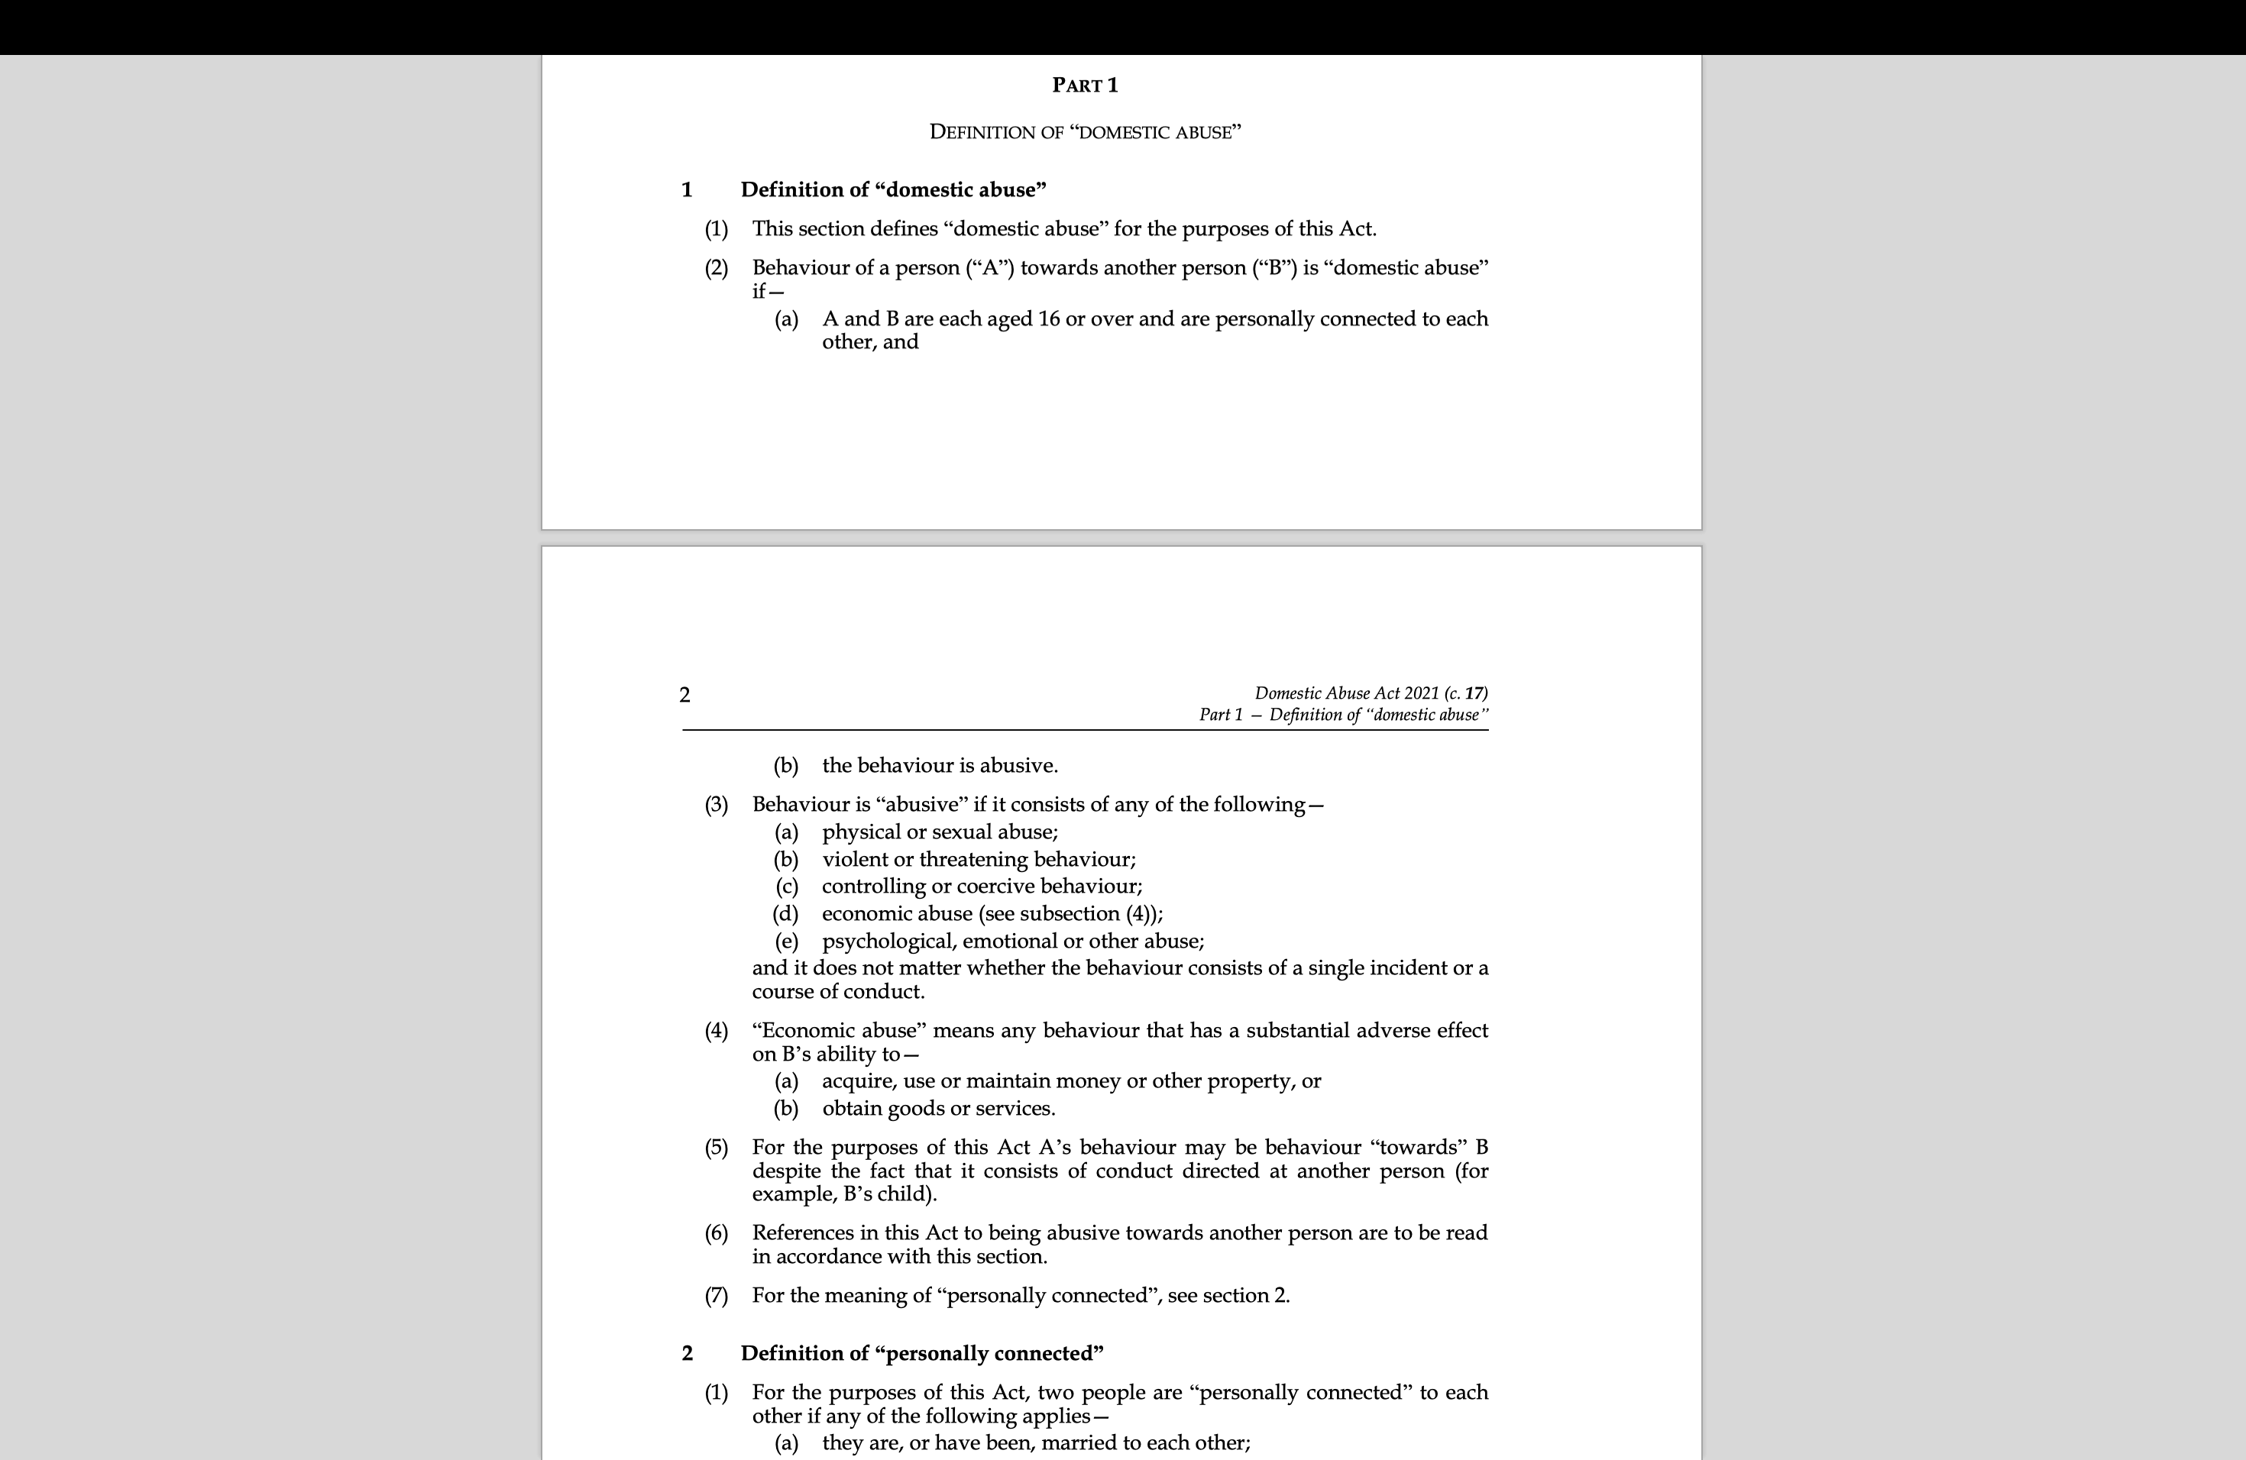
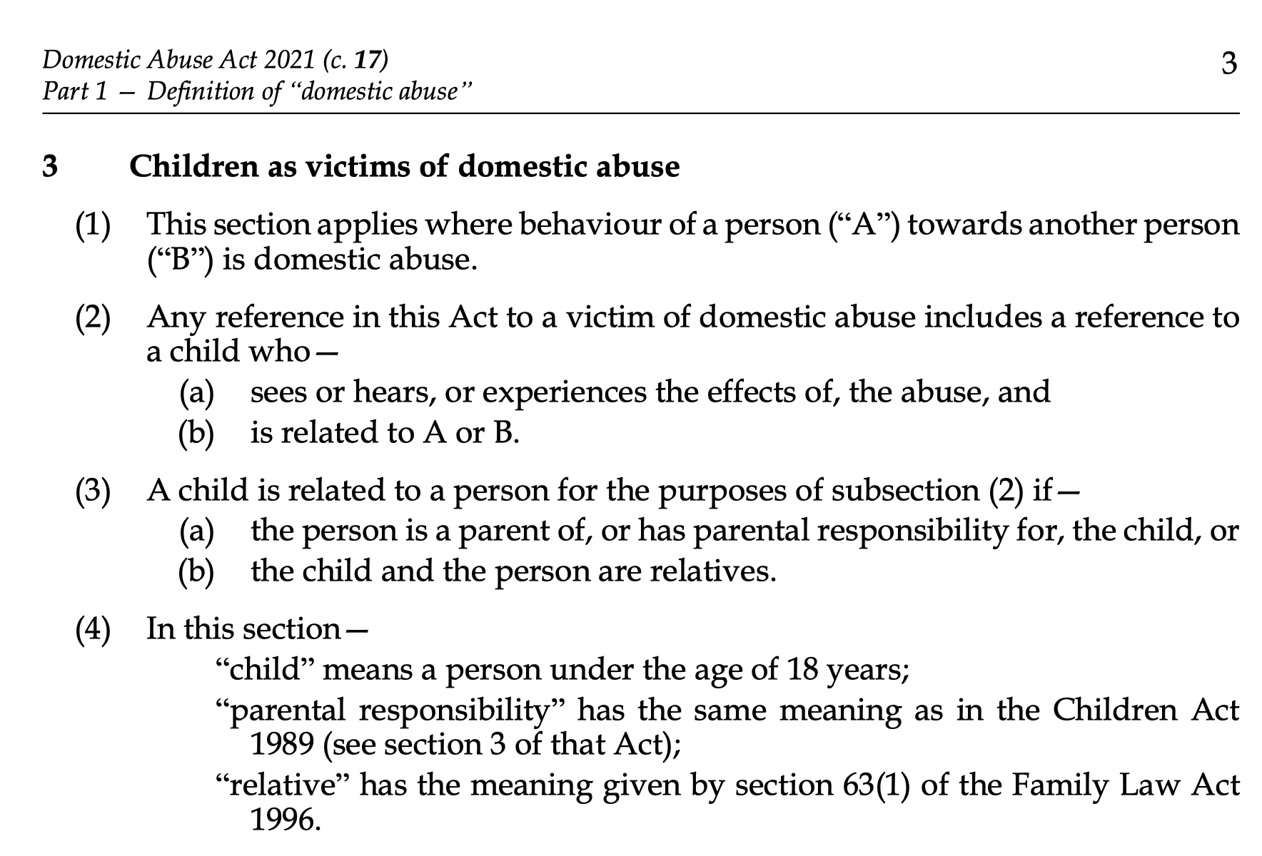
The Domestic Abuse Act 2021
Section 1, Domestic Abuse Act 2021
Section 3, Domestic Abuse Act 2021

Slide 34
PD12J, paragraphs 25-27
Interim Orders before determination of relevant facts
25 Where the court gives directions for a fact-finding hearing, or where disputed allegations of domestic abuse are otherwise undetermined, the court should not make an interim child arrangements order unless it is satisfied that it is in the interests of the child to do so and that the order would not expose the child or the other parent to an unmanageable risk of harm (bearing in mind [in particular the definition of `victim of domestic abuse' and] the impact which domestic abuse against a parent can have on the emotional well-being of the child, the safety of the other parent and the need to protect against domestic abuse).
26 In deciding any interim child arrangements question the court should–
a. take into account the matters set out in section 1(3) of the Children Act 1989 or section 1(4) of the Adoption and Children Act 2002 ('the welfare check-list'), as appropriate; and
b. give particular consideration to the likely effect on the child, and on the care given to the child by the parent who has made the allegation of domestic abuse, of any contact and any risk of harm, whether physical, emotional or psychological, which the child and that parent is likely to suffer as a consequence of making or declining to make an order.
27 Where the court is considering whether to make an order for interim contact, it should in addition consider –
a. the arrangements required to ensure, as far as possible, that any risk of harm to the child and the parent who is at any time caring for the child is minimised and that the safety of the child and the parties is secured; and in particular:
Whether the contact should be supervised or supported, and if so, where and by whom; and
the availability of appropriate facilities for that purpose;
b. if direct contact is not appropriate, whether it is in the best interests of the child to make an order for indirect contact; and – SORT IT OUT!!
c. whether contact will be beneficial for the child.

Slide 35
PD12J, paragraphs 35-37
Factors to be taken into account when determining whether to make child arrangements orders in all cases where domestic abuse has occurred
35 When deciding the issue of child arrangements the court should ensure that any order for contact will not expose the child to an unmanageable risk of harm and will be in the best interests of the child.
36 (1) In the light of –
any findings of fact,
admissions; or
domestic abuse having otherwise been established,
the court should apply the individual matters in the welfare checklist with reference to the domestic abuse which has occurred and any expert risk assessment obtained.
(2) In particular, the court should in every case consider any harm –
which the child as a victim of domestic abuse, and the parent with whom the child is living, has suffered as a consequence of that domestic abuse; and
which the child and the parent with whom the child is living is at risk of suffering, if a child arrangements order is made.
(3) The court should make an order for contact only if it is satisfied –
that the physical and emotional safety of the child and the parent with whom the child is living can, as far as possible, be secured before, during and after contact; and
that the parent with whom the child is living will not be subjected to further domestic abuse by the other parent.
37 In every case where a finding or admission of domestic abuse is made, or where domestic abuse is otherwise established, the court should consider the conduct of both parents towards each other and towards the child and the impact of the same. In particular, the court should consider –
the effect of the domestic abuse on the child and on the arrangements for where the child is living;
the effect of the domestic abuse on the child and its effect on the child's relationship with the parents;
whether the parent is motivated by a desire to promote the best interests of the child or is using the process to continue a form of domestic abuse against the other parent;
the likely behaviour during contact of the parent against whom findings are made and its effect on the child; and
the capacity of the parents to appreciate the effect of past domestic abuse and the potential for future domestic abuse.

Slide 36
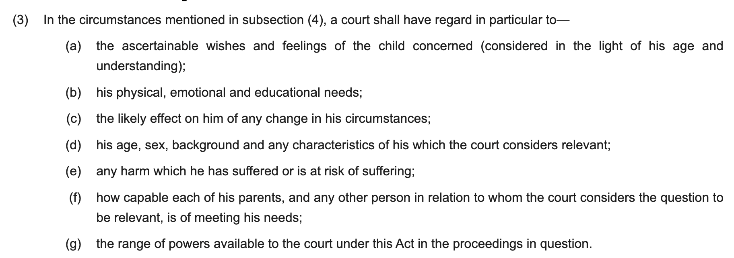
The welfare checklist contained in section 1(3) Children Act 1989

Slide 37
V v V & Anor [2025] EWHC 945 (Fam) - Analysis Continued
Re H-N and Others (children) (domestic abuse: finding of fact hearings) [2021] EWCA Civ 448, paragraphs 31 and 32:
‘31. The circumstances encompassed by the definition of 'domestic abuse' in PD12J fully recognise that coercive and/or controlling behaviour by one party may cause serious emotional and psychological harm to the other members of the family unit, whether or not there has been any actual episode of violence or sexual abuse. In short, a pattern of coercive and/or controlling behaviour can be as abusive as or more abusive than any particular factual incident that might be written down and included in a schedule in court proceedings (see 'Scott Schedules' at paragraph 42 -50). It follows that the harm to a child in an abusive household is not limited to cases of actual violence to the child or to the parent. A pattern of abusive behaviour is as relevant to the child as to the adult victim. The child can be harmed in any one or a combination of ways for example where the abusive behaviour:
i) Is directed against, or witnessed by, the child;
ii) Causes the victim of the abuse to be so frightened of provoking an outburst or reaction from the perpetrator that she/he is unable to give priority to the needs of her/his child;
iii) Creates an atmosphere of fear and anxiety in the home which is inimical to the welfare of the child;
iv) Risks inculcating, particularly in boys, a set of values which involve treating women as being inferior to men.

Slide 38
V v V & Anor [2025] EWHC 945 (Fam) - Analysis Continued
Key Case Law - Re H-N and Others (children) (domestic abuse: finding of fact hearings) [2021] EWCA Civ 448, continued
‘‘ 32. It is equally important to be clear that not all directive, assertive, stubborn or selfish behaviour, will be 'abuse' in the context of proceedings concerning the welfare of a child; much will turn on the intention of the perpetrator of the alleged abuse and on the harmful impact of the behaviour. We would endorse the approach taken by Peter Jackson LJ in Re L (Relocation: Second Appeal) [2017] EWCA Civ 2121 (paragraph 61):
"Few relationships lack instances of bad behaviour on the part of one or both parties at some time and it is a rare family case that does not contain complaints by one party against the other, and often complaints are made by both. Yet not all such behaviour will amount to 'domestic abuse', where 'coercive behaviour' is defined as behaviour that is 'used to harm, punish, or frighten the victim…' and 'controlling behaviour' as behaviour 'designed to make a person subordinate…' In cases where the alleged behaviour does not have this character it is likely to be unnecessary and disproportionate for detailed findings of fact to be made about the complaints; indeed, in such cases it will not be in the interests of the child or of justice for the court to allow itself to become another battleground for adult conflict'

Slide 39
V v V & Anor - Take Home Points
The decision to embark upon a finding of fact hearing must lead to a review of the appropriateness and safety of interim contact.
The court, practitioners and professionals must consider PD12J and the impact of any interim contact on both the victim and the child victim.
The impact of stopping or altering contact for a child has to be considered as part of the welfare checklist (section 1(3), Children Act 1989), weighed up, balanced and viewed in the context of a decision to direct a finding of fact hearing.

Slide 40
THANK YOU

