Slide 1
“But She Should Have Known It Was Illegal”
Stakeholder knowledge and response to disclosures of online harms
Andy Phippen
aphippen1@bournemouth.ac.uk
phippenandy@gmail.com

Slide 2
Agenda
Child safety discourse
Online harms and expectations of knowledge
Impact on young people
Role of the law?
Are things improving?

Slide 3
About me
20 years research in online issues, mainly with young people
  First five years: “What are young people doing online?”
  Next five years: “What do young people want from adults regarding online safety?”
  And the next: “Why aren’t you implementing national policies that align with what young people have been advocating for over the past decade??”
  Currently: “Ah, prohibition again. Well that always works doesn’t it!?”
Headstart Kernow: https://www.headstartkernow.org.uk/digital-resilience

Slide 4
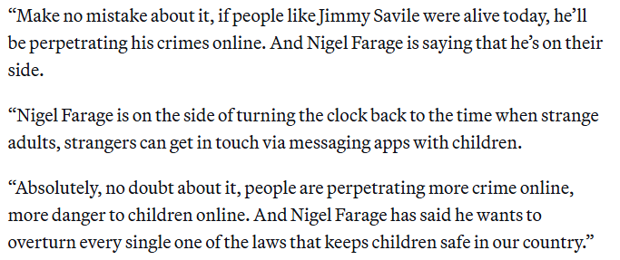
https://www.politico.eu/article/nigel-farage-on-the-side-predator-jimmy-savile-says-uk-minister-peter-kyle-online-safety-act/

Slide 5
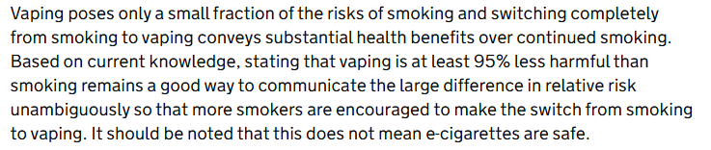
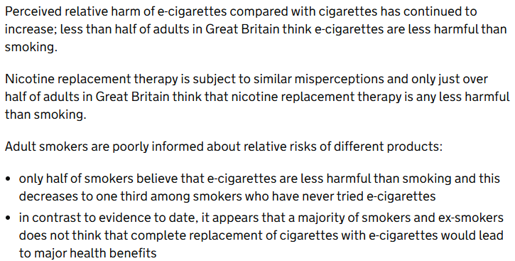
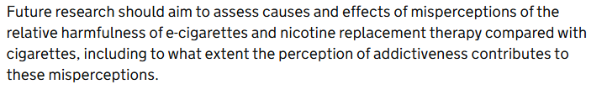
https://www.gov.uk/government/publications/e-cigarettes-and-heated-tobacco-products-evidence-review/evidence-review-of-e-cigarettes-and-heated-tobacco-products-2018-executive-summary

Slide 6
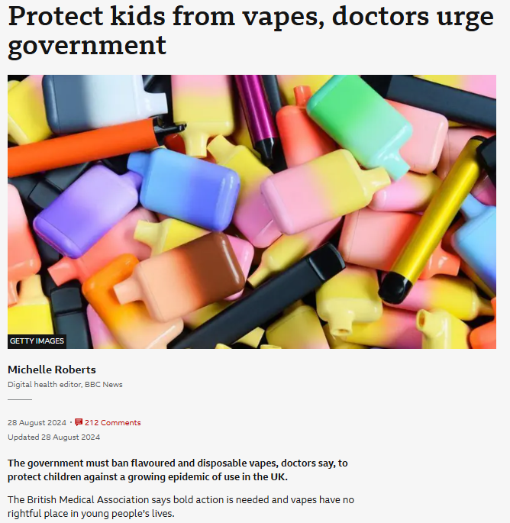
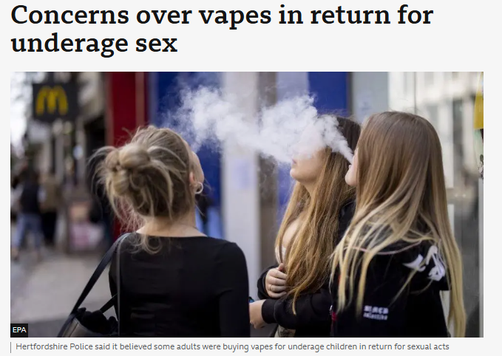
https://www.bbc.co.uk/news/articles/cq82dlv1g3lo
https://www.bbc.co.uk/news/articles/cdxv9pwrvj9o

Slide 7
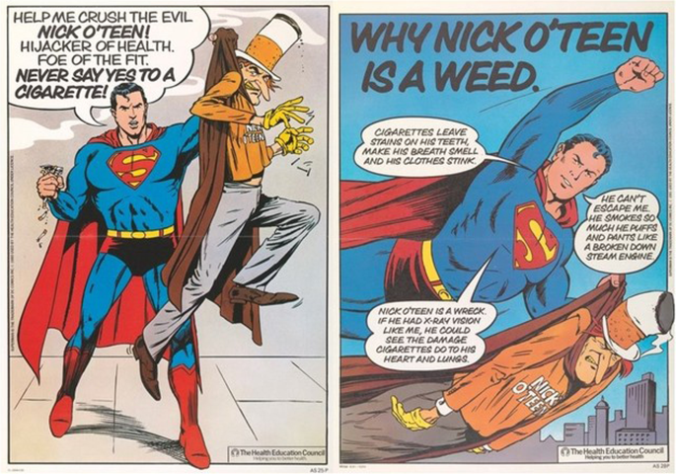
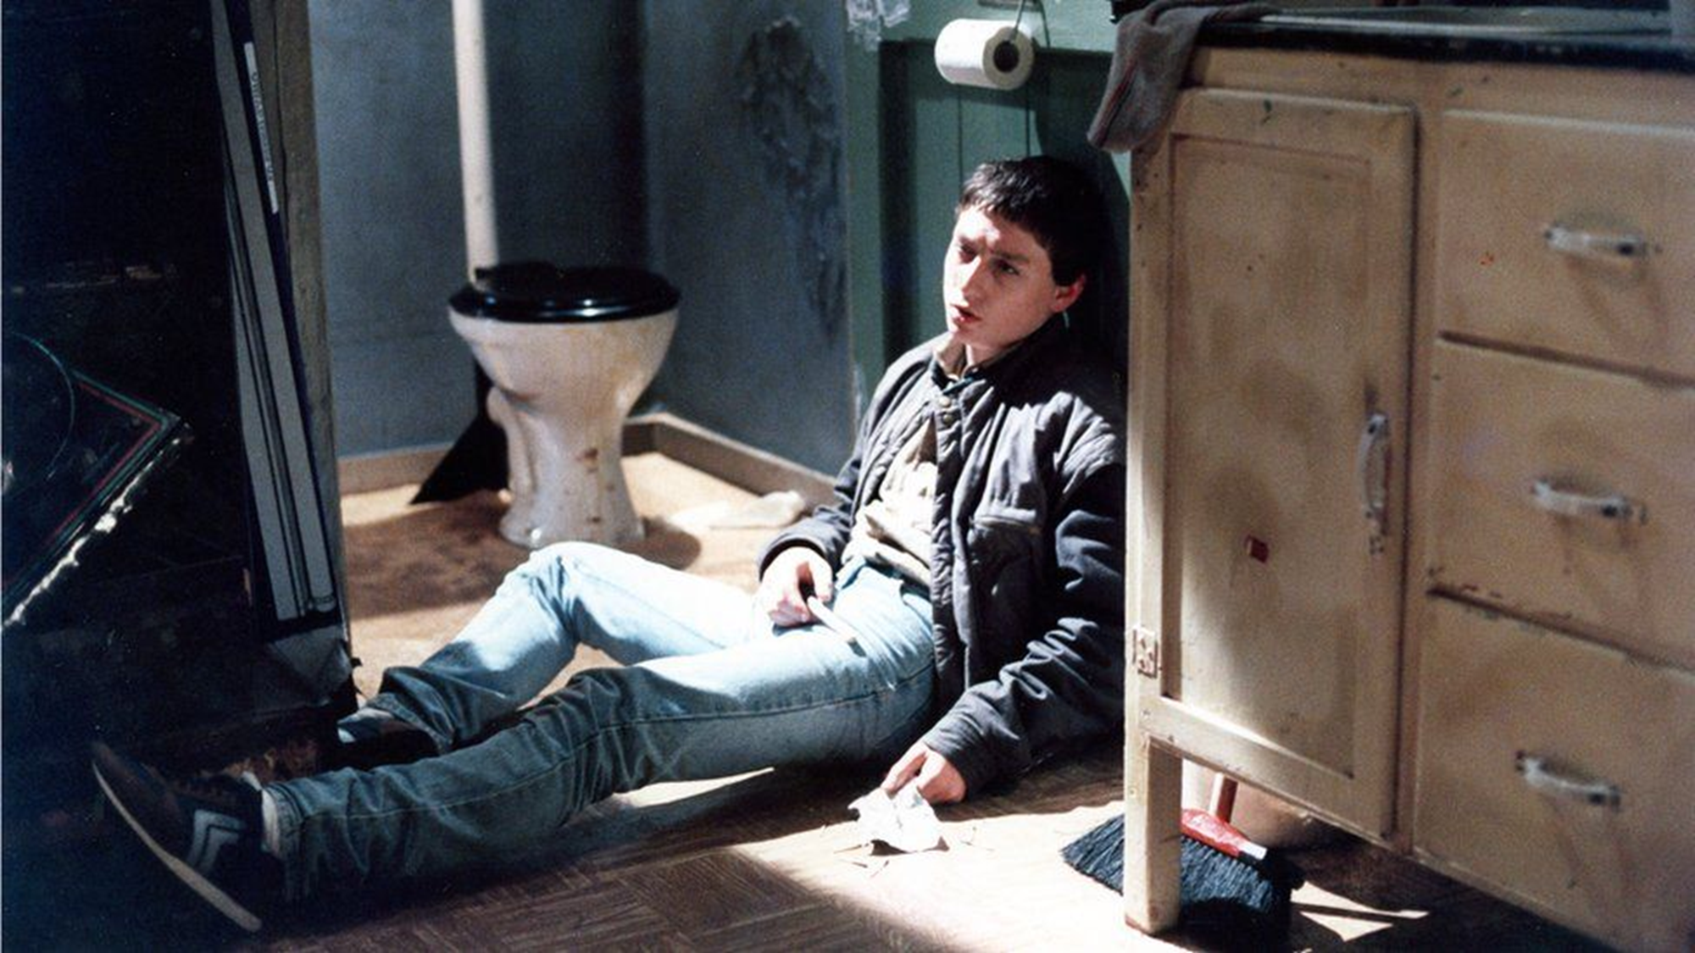

Slide 8

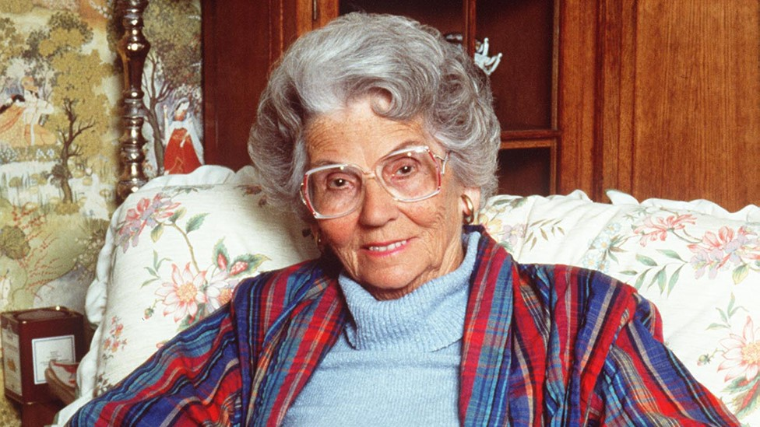

Slide 9
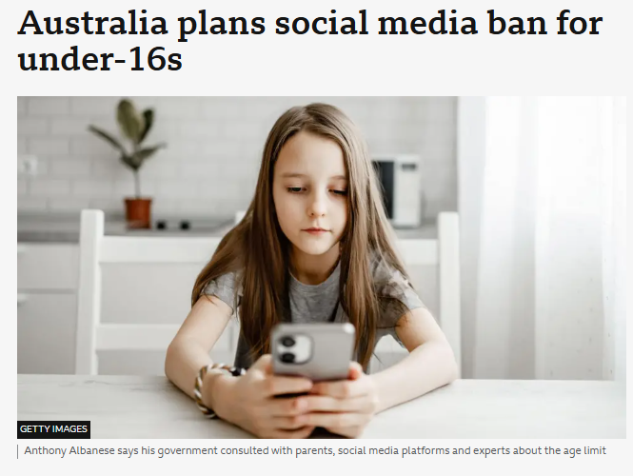
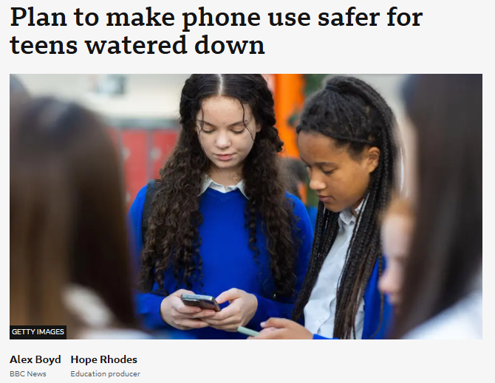
https://www.bbc.co.uk/news/articles/c4gzd62g1r3o
https://www.bbc.co.uk/news/articles/cq8y7dvw9ddo

Slide 10
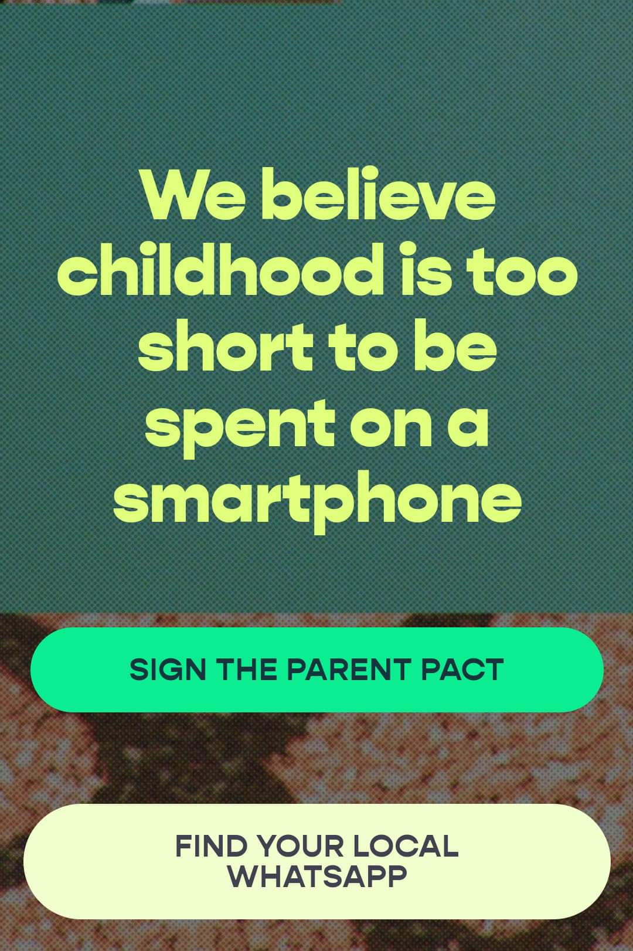

Slide 11
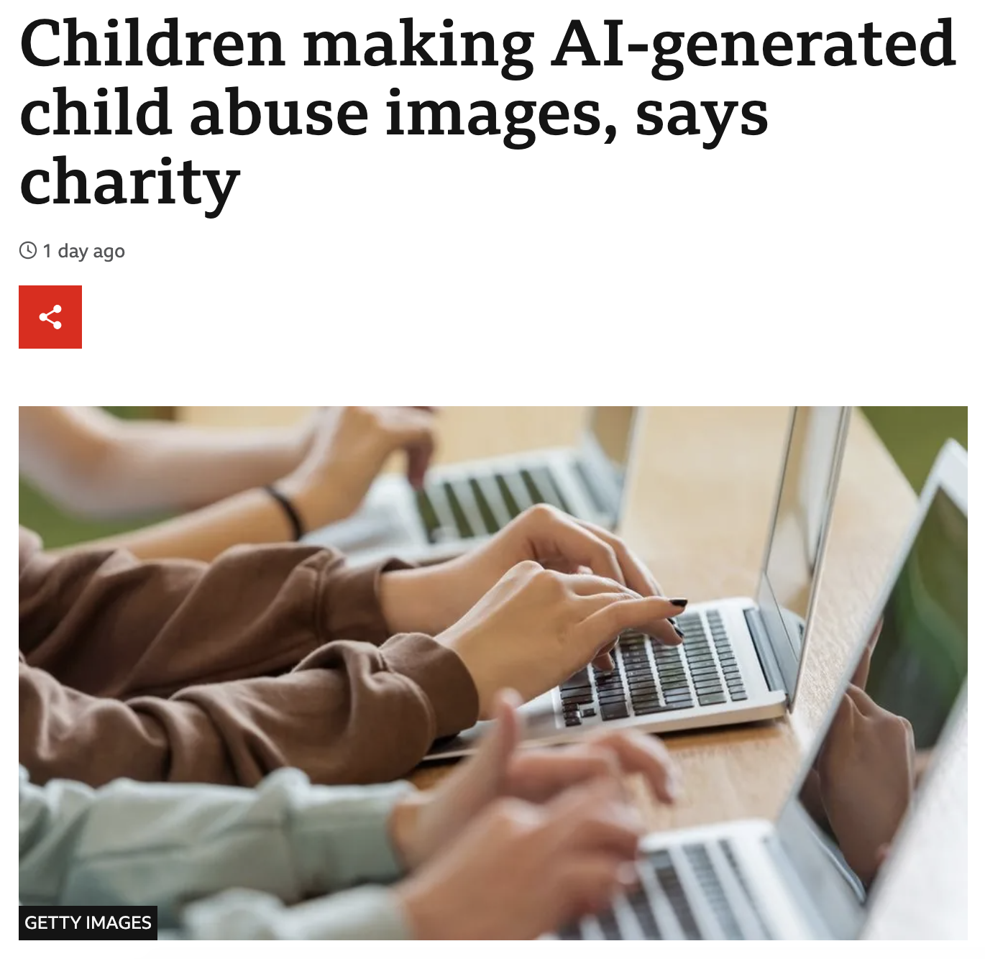
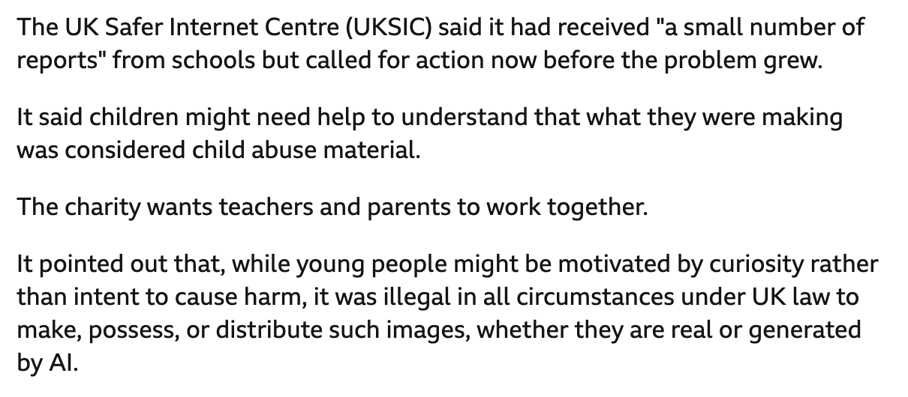
https://www.bbc.co.uk/news/technology-67521226

Slide 12
“Its best to just ignore what adults tell you”
A young person, aged 17, June 2021.

Slide 13
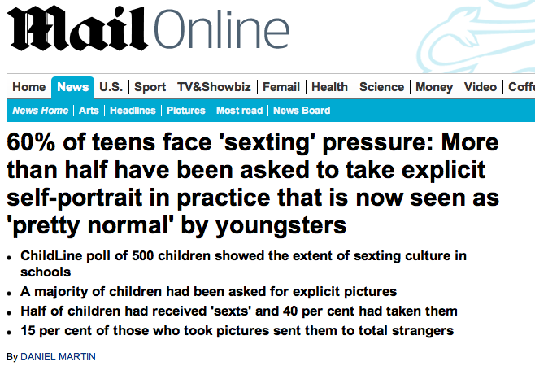
2013: http://www.dailymail.co.uk/news/article-2463751/Sexting-More-half-teens-asked-explicit-self-portraits.html
Notes:
http://www.dailymail.co.uk/news/article-2463751/Sexting-More-half-teens-asked-explicit-self-portraits.html

Slide 14
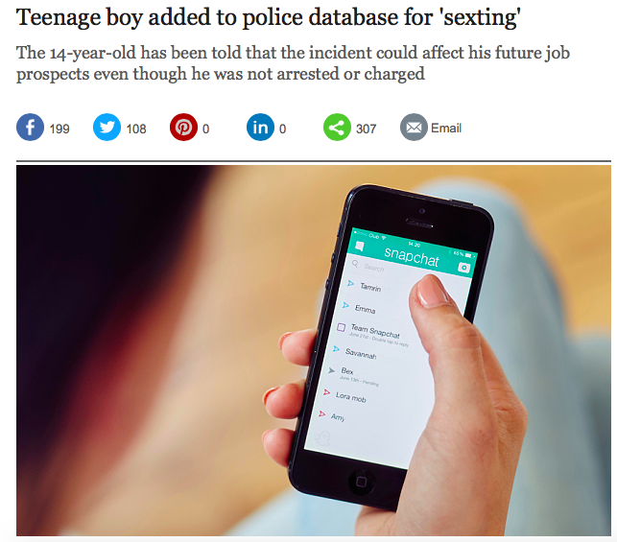
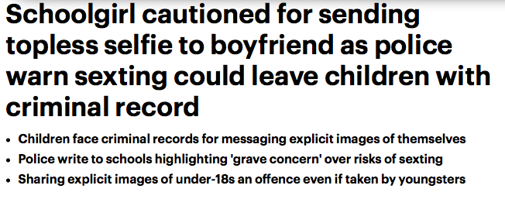
2015 - http://www.dailymail.co.uk/news/article-2702157/Sexting-leave-criminal-record-teenagers-told-Sharing-explicit-pictures-18s-illegal-taken-themselves.html
2014 - https://www.telegraph.co.uk/news/uknews/crime/11840985/Teenage-boy-added-to-police-database-for-sexting.html

Slide 15
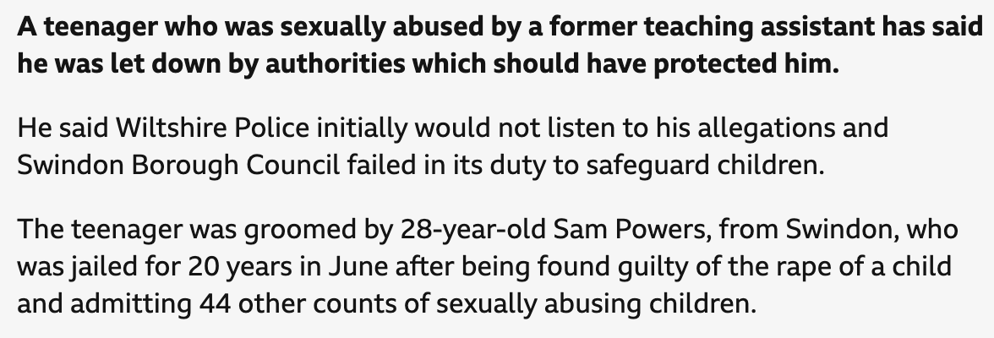
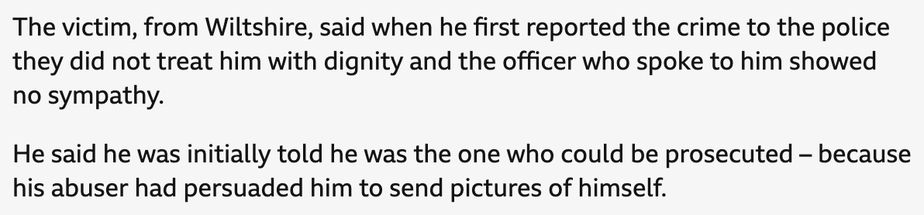
2024: https://www.bbc.co.uk/news/articles/cjrdz0qegg3o

Slide 16
Timeline
1978
Protection of Children Act 1978
1983
First commercially available mobile phone
2002
Europe’s first commercially available camera phone
2003
Sexual Offences Act amends the Protection of Children Act
2007
First iPhone released
2009
First academic studies on sexting published
Outcome 21 developed by police for cases of consensual teen sexting
2023
Online Safety Act adds new offences to the Sexual Offences Act.
2005
Term 'Sexting' is coined
2009
1980s
2016
Whatsapp launch
Polaroid one of the most popular cameras on the market

Slide 17


Slide 18
You can’t eradicate a crime by policing the behaviour of the victims

Slide 19
Outcome 21
In cases where under 18s could be charged under the PCA, but images were shared consensually between peers:
Crown Prosecution Service guidance said not in the public interest to prosecute
O21 gave police the option to close the case earlier in the process when no aggravating elements
Consensual sexual image sharing for under 18s therefore decriminalized
But recorded and could be returned on Enhanced DBS
Outcome 22??

Slide 20
Recent comment from a presentation by an Online Sexual Abuse Charity
“Disclosing and the subsequent fall out was worse than the abuse”
https://survivorsintransition.co.uk/

Slide 21
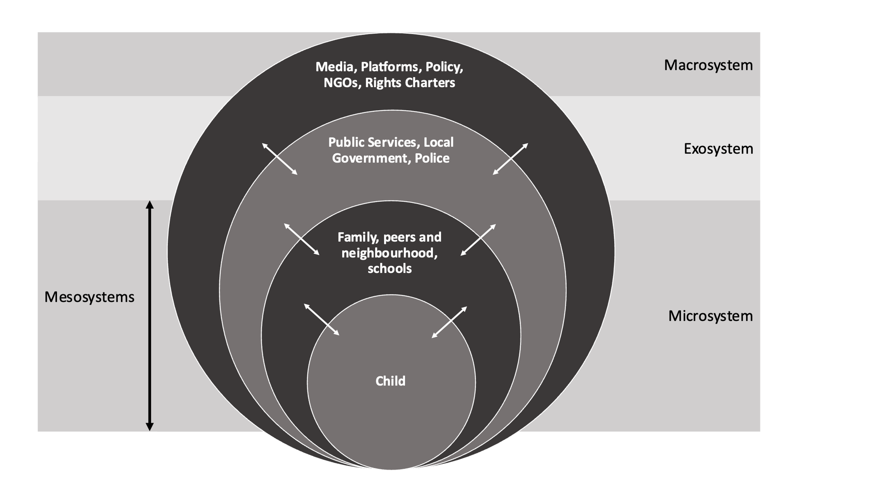
Phippen, A. (2025). Policy and Rights Challenges in Children’s Online Behaviour and Safety, 2017–2023. Springer
http://link.springer.com/book/10.1007/978-3-031-80286-7

Slide 22

The Harm Reduction Approach
Accept it is happening
Understand it is complex
Abstinence may not be the best outcome
Non-judgemental response
Give YP a voice
See YP as primary agents of change
Consider how inequality affects vulnerability
Do not minimise the harm
Notes:
Adapted from the Principles of Harm Reduction https://harmreduction.org/about-us/principles-of-harm-reduction/

Slide 23
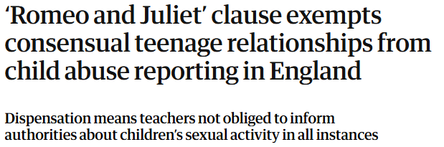
Improvement?
https://www.theguardian.com/society/2025/apr/16/romeo-and-juliet-clause-exempts-consensual-teen-relationships-from-child-abuse-reports

Slide 24
Listen;
Don’t Judge;
Understand.

