Slide 1



Forensic Risk Assessment
Professor Jane L. Ireland
Liverpool John Moores University and Mersey Care NHS Foundation Trust
J.Ireland@ljmu.ac.uk
Jane@tiofp.com

Slide 2
Aims
To provide a summary on risk assessments: Focus on aggression/violence
To capture the history of application & problems
Current preferred focus

Slide 3
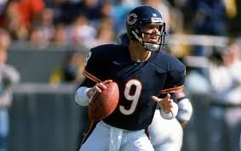
Historical Developments
“Yes, risk taking is inherently failure-prone. Otherwise, it would be called sure-thing-taking”
Jim McMahon

Slide 4
A bit of history...
1950s
Assumption that mental health professionals (e.g., psychiatrists) simply knew who was going to be dangerous and who was not.
1960s
Enter the case of Johnny Baxstrom…..
Notes:
4

Slide 5
Johnny Baxstrom
Convicted of 2nd degree assault and sentenced to a US prison.
Certified ‘insane’ and transferred to a US State Hospital.
Scheduled for release in 1961 – yet his continued incarceration was argued on the basis he remained ‘insane’ and ‘dangerous.’
Twice filed for unlawful detention - declined each time.
Requested transfer to a civil institution: Declined despite state attorney support.
Various appeals. Supreme Court granted judicial review.

Slide 6
Court held that Mr Baxstrom was denied equal protection of the laws :
Has been denied a review of his civil commitment by a jury.
Was civilly committed in prison without judicial determination that he was dangerously mentally ill.
Following this case and decision to release, approx. 1,000 civilly committed individuals were also released.
Less than 3% of those released had later returned to prison or a hospital for the ‘criminally insane.’ This finding was used to argue psychiatrists overestimate the danger posed by their patients (Steadman and Keveles, 1972).
Concept of ‘False Positives’ was born in this area of practice.

Slide 7
Post Baxstrom…..
Late 1970s to 1980s: academics and practitioners questioned how risk assessments could be improved.
1981 concept of actuarial vs. clinical debate asserted and a call for prediction-outcome studies.
1990s: the rise of actuarial measures e.g. VRAG/VRAG-R.
Mid 1990s – to now: development of structured clinical judgements e.g. HCR-20; SAVRY; SVR-20; SARA; B-SAFER.
Notes:
7

Slide 8

2010 onwards - enter the concept of protective factors as well as risk factors, e.g. SAPROF; SAPROV-YV
And….researchers have just recently started to build on concepts first coined in 2008 (Loeber et al, 2008) but now making a real entry to the area i.e.
“Promotive factors”
Promotive are distinct concepts from protective and risk but are part of the risk concept (Farrington et al, 2016).
Notes:
8

Slide 9
More recognition of the need to consider risk in more detail. Consider risk statements…
(Scott and Resnick, 2006)
1.) Magnitude of potential harm threatened?
“Threatening to shoot someone in the head foreshadows a much greater risk of serious harm than threatening to kick someone in the leg”
2.) Likelihood that the violent act may take place;
3.) Imminence of the harm;
4.) Frequency of the behaviour;
5.) What situational factors are relevant?
Notes:
9

Slide 10
A detailed example template…. (copyright TIOFP, 2025)
This can be used to pull together a few paragraphs for a risk statement.
You have been given a copy of this…..

Slide 11
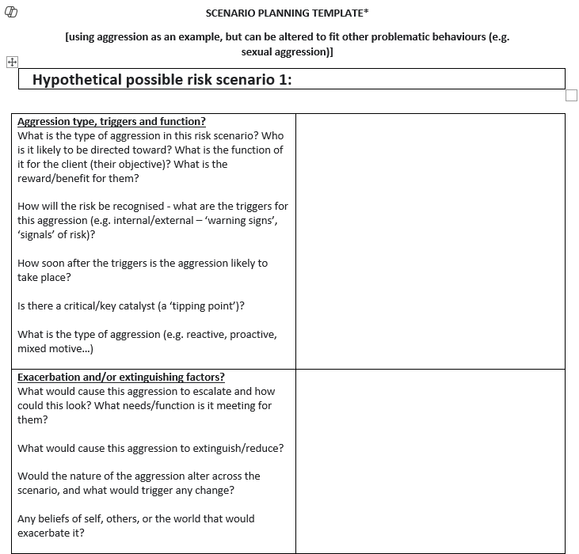

Slide 12
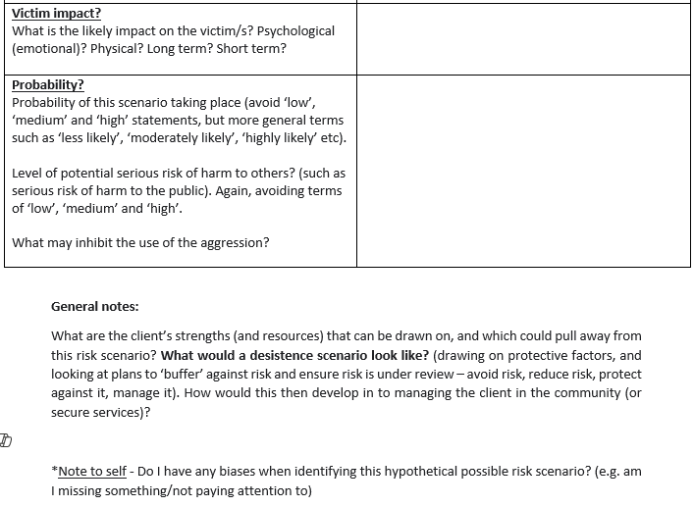

Slide 13
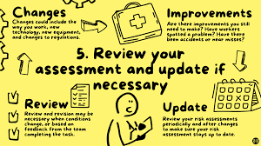
So…with all this in mind, what have been the approaches to risk assessment over the years?

Slide 14
Approaches
Unstructured clinical (first generation)
Actuarial/statistical (second generation)
Dynamic, actuarial and clinical (third generation)
Dynamic, actuarial, clinical and protective factors
Notes:
14

Slide 15
Unstructured Clinical (First Generation)
Professional/clinical opinion: ‘The professional gut’
Decision-making process solely in their head (Dawes, Faust & Meehl, 1989)
‘Moderately Accurate’ – more so than chance in some studies (Borum, 1996)
BUT - if you use your own ungrounded theories/ideas to inform your judgement, this is referred to as “guided clinical judgement” – the method of “hypo-deduction” [the ‘Sherlock Holmes’ approach!!]
Notes:
15

Slide 16
Estimates of risk informed only by intuitive clinical experience (O’Dowd et al, 2023):
Often anecdotal and unstandardized (O’Dowd et al, 2023)
Clinicians decide which factors to consider and how much weight to attribute to them (O’Dowd et al, 2023) – lots of bias can come into this!
The current consensus in the research is that this method lacks reliability, validity and transparency (Levin, 2019).

Slide 17
It’s not all bad….more a clinician’s value is not being used in the best way…kind of….
“clinical judgment has been undervalued in previous research. Not only did the clinicians pick out a statistically more violent group, but the violence that the predicted group committed was more serious than the acts of the comparison group. Nonetheless, the low sensitivity and specificity of these judgments show that clinicians are relatively inaccurate predictors of violence”
(Lidz et al, 1993)

Slide 18
Problems…..
Unreliable
Subjective
Not easily observable
Difficult to replicate
Only correct 1 out of 3 times
‘False positives’
Notes:
18

Slide 19

‘False positives’
Predicting any low frequency act is difficult and error prone – problem with the low base rate (e.g. Yang, Wong and Coid, 2010)
“Even with a moderately accurate method of prediction, predicting low or very-low-frequency events, such as serious violence....will inevitably result in a high false-positive rate” (Yang et al, 2010, p 741).
Notes:
19

Slide 20

‘False negatives’
This, of course, also occurs – where we fail to identify risk or we minimise it.
It can be a bias – for example, failing to account for aggression risks among women, presuming that male partners are the perpetrators and/or provokers.
Notes:
20

Slide 21

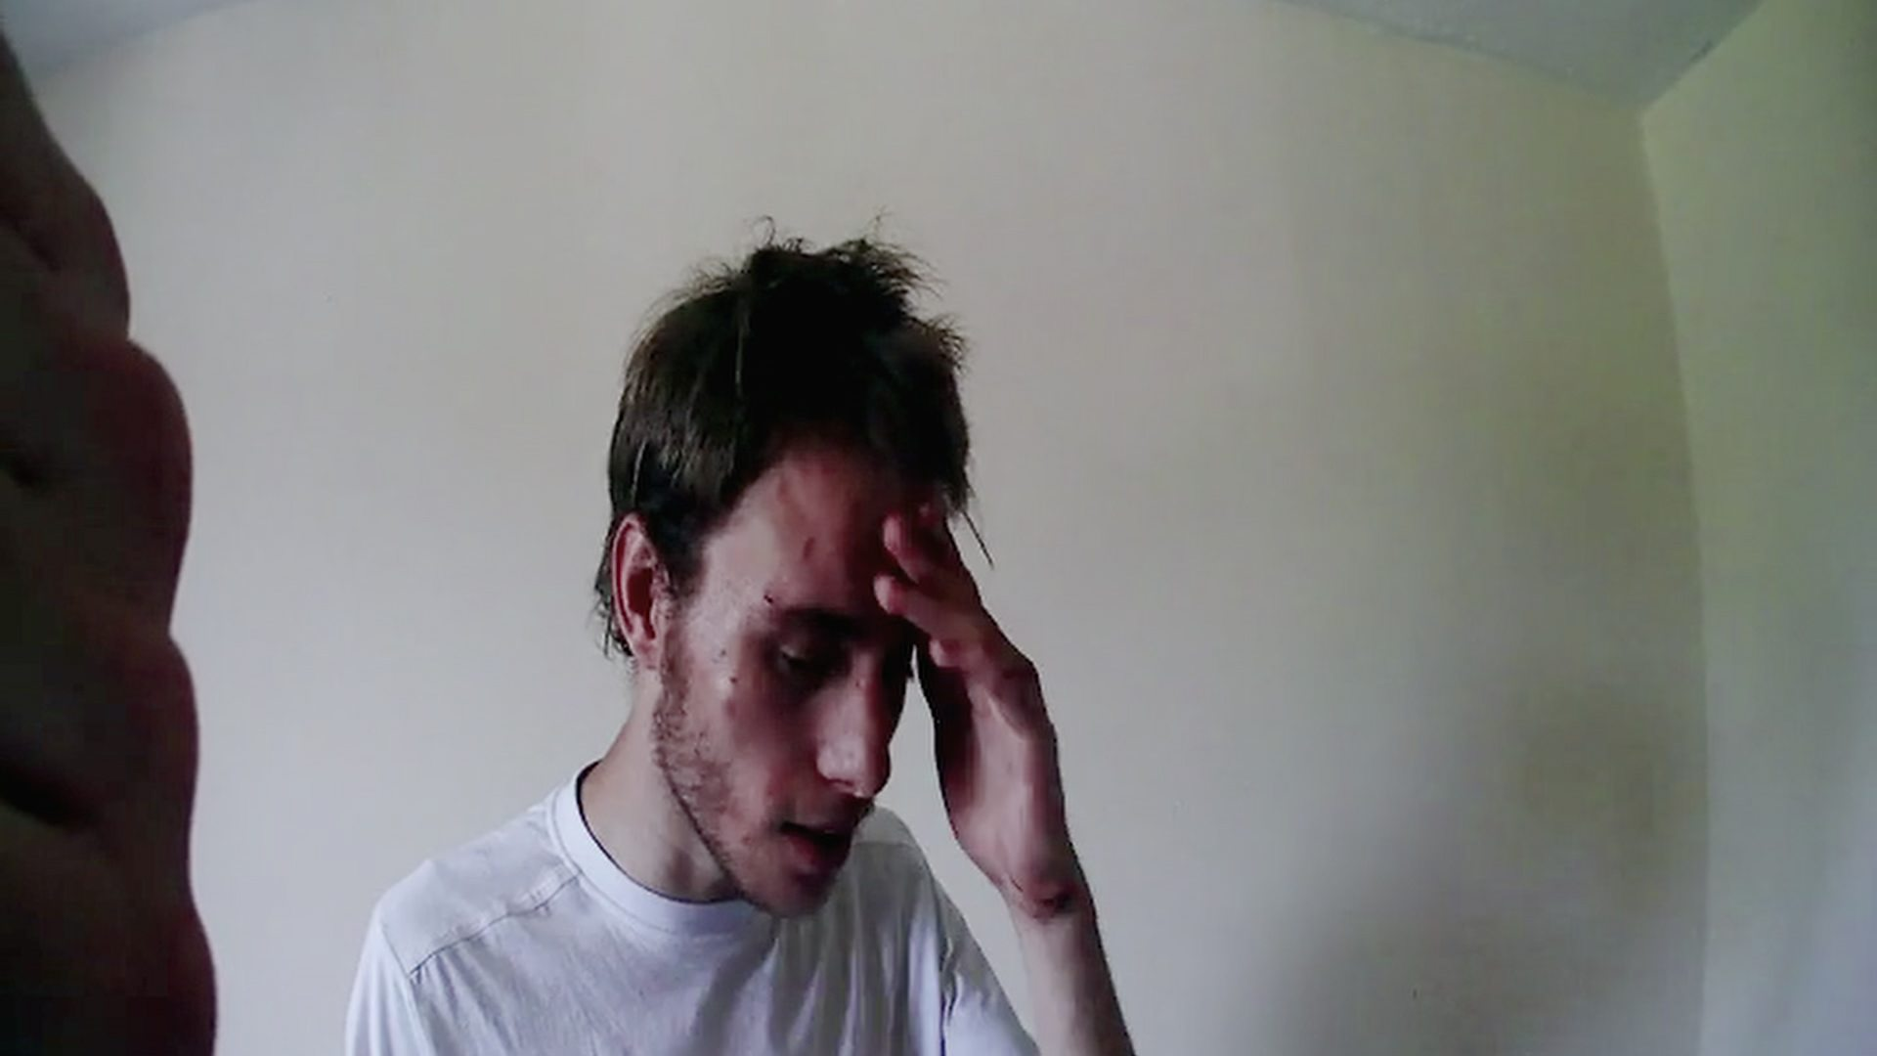
Alex Skeel case: Partner, Jordan Worth first woman jailed for coercive and controlling behaviour in the UK. Received 7.5 years –
Denial of food
Physical assaults with weapons (attacks whilst sleeping to request what he was thinking), use of hammers, knives, boiling water….had two children together.
Feared his limbs may need amputating post the abuse.
Was self-treating injuries with cling-fluid
By time the police intervened Alex’s body was shutting down.
Jordan Worth: came from a ‘loving and supportive family’. Had volunteered to help abandoned animals, raised money for children in Africa, aspired to be a teacher. Had a degree. Risk markers were not uniform!

Slide 22
Actuarial/Statistical (Second Generation)
Criticisms drove development of the second generation risk assessment approach
‘Clinical vs. Actuarial/statistical debate’ first noted by Meehl (1954).
The assumption here is past behaviour = best predictor of future behaviour.
Static information fed into a formula to give you a ‘risk score’.
Superior to unstructured clinical (first generation) approach but, superiority not uniform. Just because everyone arrives at the same answer, it does not mean the answer is correct!

Slide 23
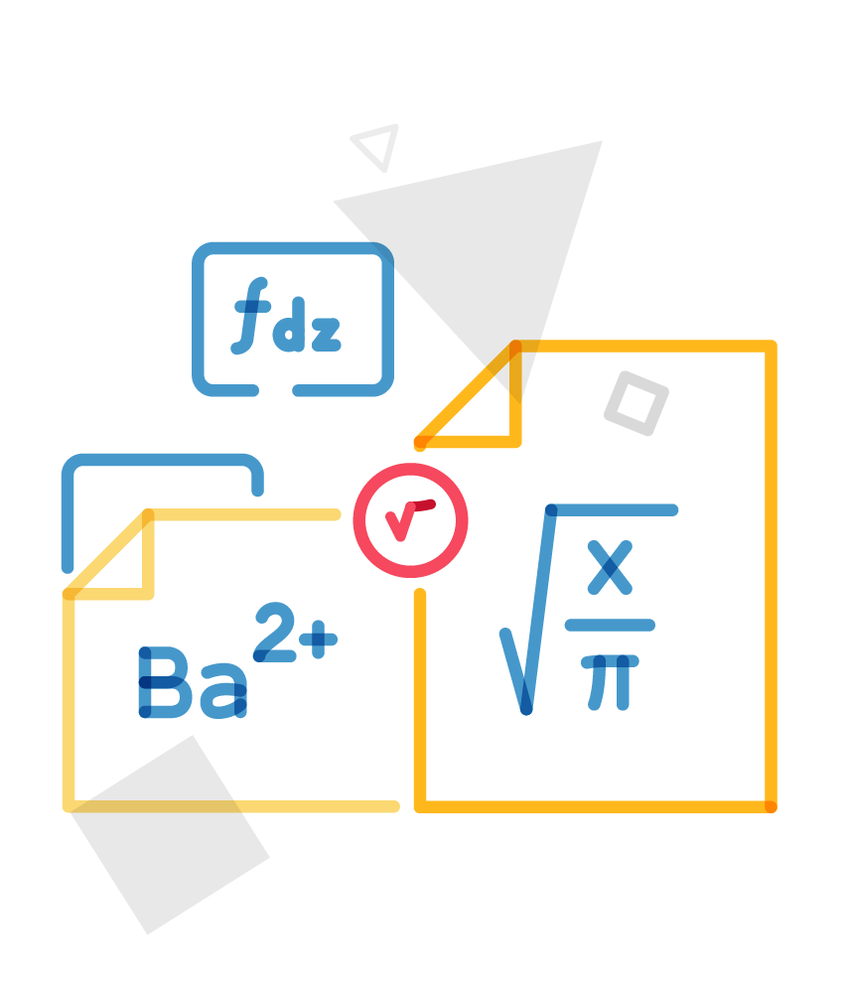
Uses statistical method, assigning points to factors to produce a numerical score for the risk of re-offending (Bertsch et al, 2022).
Based on static factors – historical, stable over time [so, no dynamic, changeable factors are considered!].
They argue and market the value of offering objective, mechanical and reproducible measures of re-offending risk.
They remove the risk of clinician bias by not inviting the opinion of the assessor [BUT there is a large BUT coming…..]
They are simple and quick to use.

Slide 24

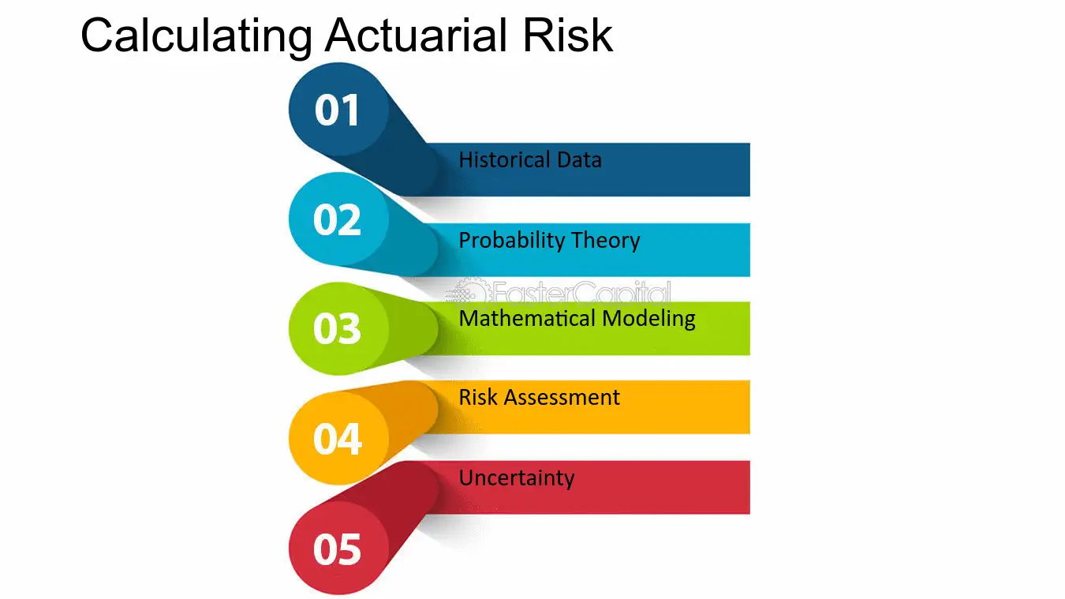

Gaslighting with statistics?

Slide 25

BUT...
Scales/tools are seen as too rigid. Do not account for change, something called the ‘Broken Leg Problem’ (Meehl, 1954; Dawes et al, 1989).
Problems applying them to women.
They do not capture unusual offences well.
Focus on long term risk.
Do not capture severity.
Based on probability only.
Do not tie into risk management or care planning (e.g. O’Dowd et al, 2023).…..the list goes on and on.

Slide 26
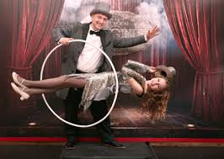
BUT they give the illusion of certainty….a number. We all love a good clear number…..and a good illusion…..
BUT even the number is not really based in solid irrefutable science….

Slide 27
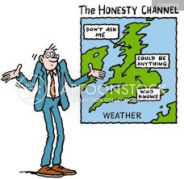
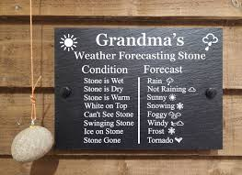
Afterall, we do not trust in the weather forecast, which uses the same principles….
But we trust more what we can see in real time.

Slide 28
Enter: Structured Professional Judgement – SPJ’s (Third Generation)
Developed as:
“One attempt to find middle ground has been structured clinical risk assessment”
(Hilton, Harris and Rice, 2006).
Notes:
28

Slide 29
Enter the Structured Professional Judgement – SPJ’s (Third Generation)
SPJ’s are a ‘merging’ of the unstructured clinical judgment and actuarial approaches [taking the best elements].
They integrate empirically supported risk factors with clinical judgment, looking at the potential for future violence (Chaimowitz et al., 2020).
Offers a helpful way to organise information, communicate knowledge, and aid consensus.
Allows for a common view to be established in terms of how best to manage risk and care needs (Doyle et al., 2008; Levin et al., 2018; Nyman et al., 2020).

Slide 30
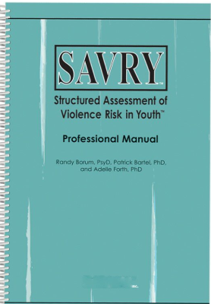
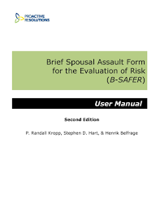
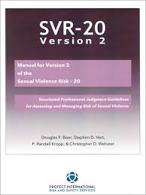
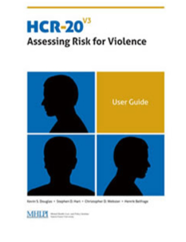
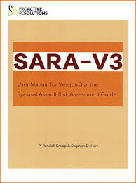

Slide 31
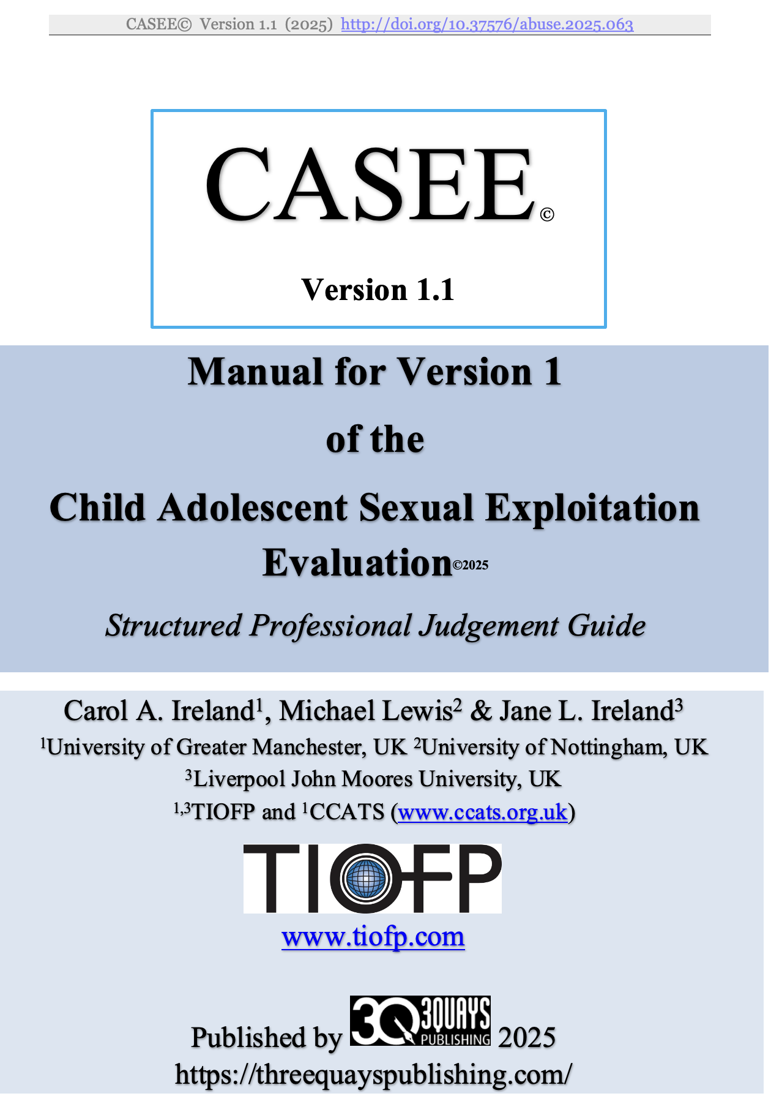
New SPJ – area is always advancing…..

Slide 32
Guides provide a series of factors to be rated on a 3-point scale – later incorporated into a formulation/risk scenario.
Examples of factors relevant to violence:
History of violence
Relationship problems
Psychopathy
Lack of insight
Substance use
Aim for individualised assessment of violence risk. Identifies need for factors to be relevant, not just present.
Sensitive to dynamic changes in risk.

Slide 33
There remain biases here we still need to manage though…
These are not always intentional.
They can be implicit….
Heuristics are a good example here.
Notes:
33

Slide 34
Judgemental heuristics
“My experience tells me they are untreatable and risky”
”All those with personality disorder are a risk”
“From my experience you can’t trust someone with paranoid schizophrenia, they can blow at any point”
“They sexually offended because of their own sexual abuse, its obvious”
Allows for ‘lower cognitive effort’ - decisions. Often captures implicit belief systems.
Can present as quite intuitive (‘it just feels to be true’) - subtle, powerful, and pervasive (Featherston et al. 2020).
Can unintentionally shape professional perceptions, problem solving, and decisions (Cooper and Meterko 2019)
Not due to dishonesty or inadequate training (Edmond et al. 2019, Neal and Grisso 2014)
Help us function in a world full of information (Neal et al, 2022) and can lead to errors.

Slide 35
We still need to guard against these factors, even with structured clinical risk assessments
Evidence does not suggest forensic practitioners exempt from bias (e.g. Dror and Murrie 2018, Murrie and Boccaccini, 2015).
Indeed, as forensic practitioners we collect and consider large amounts of information (e.g. Ackerman 2006) that we need to synthesize. No standard way of doing this.
Our opinions are thus particularly vulnerable to these biasing effects (Neal et al. 2022).
Awareness is key and managing environmental stressors that could impact on us:
stress, sleep, nourishment, open-plan offices, noise, comfort, load.

Slide 36
How can we reduce bias as much as possible?
Use methods that reduce chance for discretion in our decision making - such as structured clinical judgment methods (Guarnera et al. 2017).
Consider alternative hypotheses and ‘what if questions’ [counterfactuals] (Zapf & Dror 2017).
Seek independent peer review (Ballantyne et al. 2017).
Engage in reflective practice with self - archival self-monitoring (Gowensmith and McCallum 2019). See as CPD on occasional cases.
Don’t consider yourself immune to bias (Neal and Brodsky 2016).
* where you systematically document and analysis your own thoughts, feelings etc.

Slide 37
So, what is the ‘take home message’ from all of this?
There are unstructured clinical forms of risk assessment (‘Sherlock Holmes’/Clinical Gut’ approach).
There are actuarial forms (number-crunching)
Problems and benefits to both.
To reach a ‘middle-ground’ structured clinical risk assessments were developed (SPJ’s).
Notes:
37

Slide 38
But remember – we still do not have a good understanding of the mechanisms that could explain resulting aggression,– our understanding of moderating and mediating factors remains somewhat limited (Badruddin et al, 2024). Thus, we tend to explain aggression risk via unstructured clinical opinion still.
There are also developments on the horizon – collaborative risk assessment that involves the client in the process (Swift et al, 2025).
There is value here – it is about process of completion.
But, collaborative risk assessment is not yet fully evaluated – it is too new to determine the ‘how to’ and effects.
Notes:
38

Slide 39
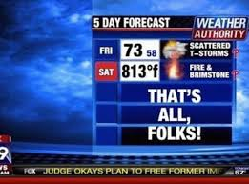
Thanks for listening!

